Slide 1
12 Grade Avid Parent Financial aid night
What you need to know

Slide 2
Senior avid camp
When: Sunday November 5th – Tuesday Nov 7th
Leave Roosevelt @12 pm on Sunday – arrive Roosevelt at 12 pm on Tuesday
Where: Salvation Army Pine Summit-Big bear lake
Cost: $75
More details on what to bring and the agenda to come

Slide 3
Middle class scholarship

Slide 4
FAFSA is the key

Slide 5
GPA

Slide 6
The big day

Slide 7
Cal grant a

Slide 8
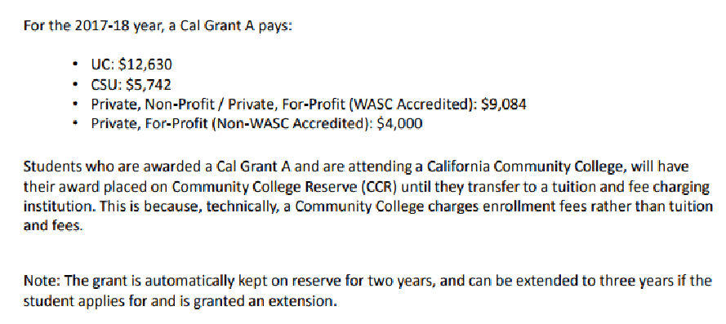

Slide 9
Cal grant b

Slide 10
Cal grant c

Slide 11
Cal Grant ????

Slide 12
Phase out of DACA

Slide 13
Dream act

Slide 14
Dream act reporting

Slide 15
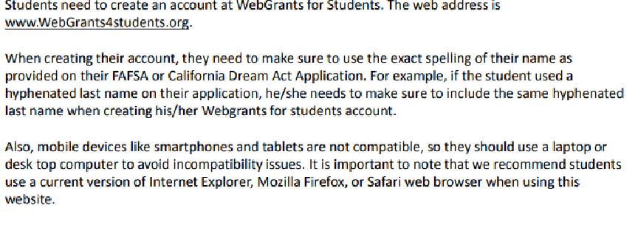
webgrants4students

Slide 16
Fafsa

Slide 17
Fafsa changes

